Slide 1

IMPOSTER CONTENT DETECTION
Submitted to - Amir Khan Sir
(Technical Trainer CSE)

Slide 2
Members of team
Ojasva Saxena (191500520)
Pranjal Bansal (191500569)
Sonia Sahu (191500822)
Shreeyanshi Patwa (191500790)

Slide 3
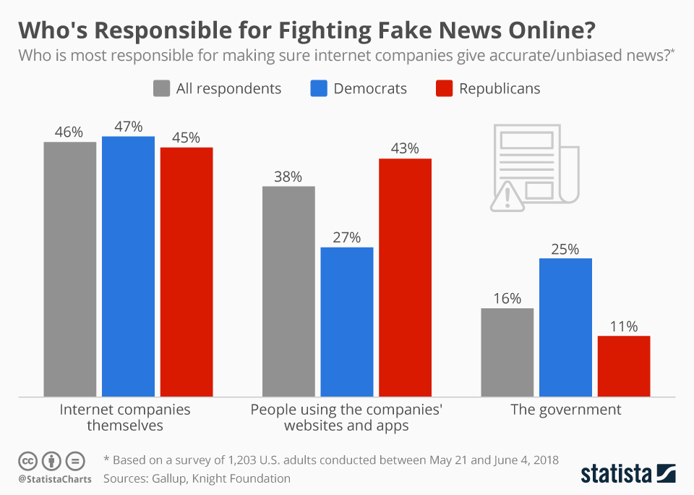
Motivation
The increment of the false news on different websites.
People believing these news and spreading them further.
The government not taking solid actions against it.
Media also playing a vital role in it and not trying to stop it.

Slide 4

Problem Statement
The requirement of a reliable source that can identify unreliable news based on the content provided.

Slide 5
Data Source
Data Source is – Kaggle
DATA ITEMS- Title, Text, Subject, Date, Class.
Label 1- Unreliable
Label 0- Reliable

Slide 6

WorkFlow

Slide 7
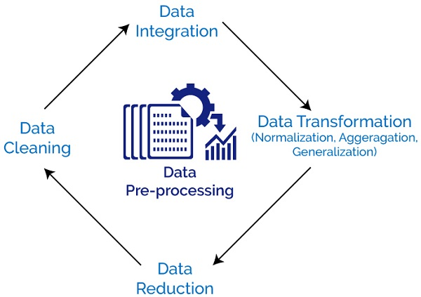
Data Pre-processing
To bring your text into a form that is predictable and analyzable for your task.
Tokenization, Steeming, Lemmatization.
Cleaning data in many ways like breaking into small chunks, simplifying tenses and using base form of the word.

Slide 8
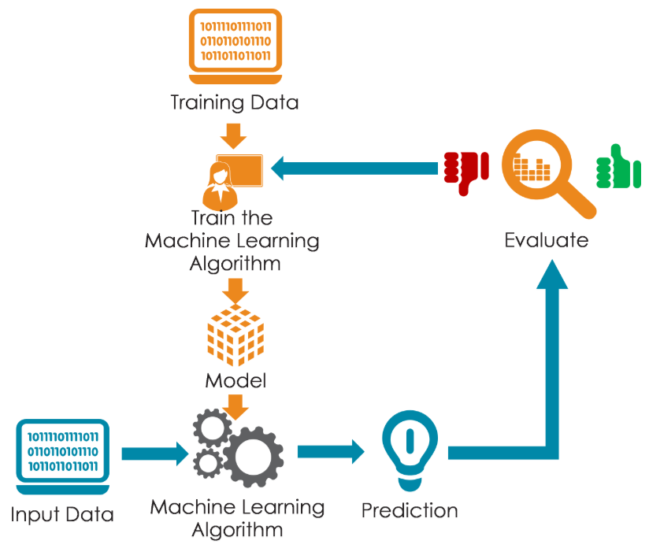
Model
Naïve Bayes
Support Vector Machine (SVM)
Decision Tree
Random Forest
Logistic Regression

Slide 9
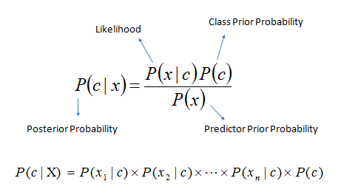
Naïve Bayes
Classification technique based on Bayes’ theorem with an assumption of independence among predictors.
Conversion of data set into frequency table.
Create likelihood table with the help of probability.
Calculating posterior probability using the given formula for each class.

Slide 10
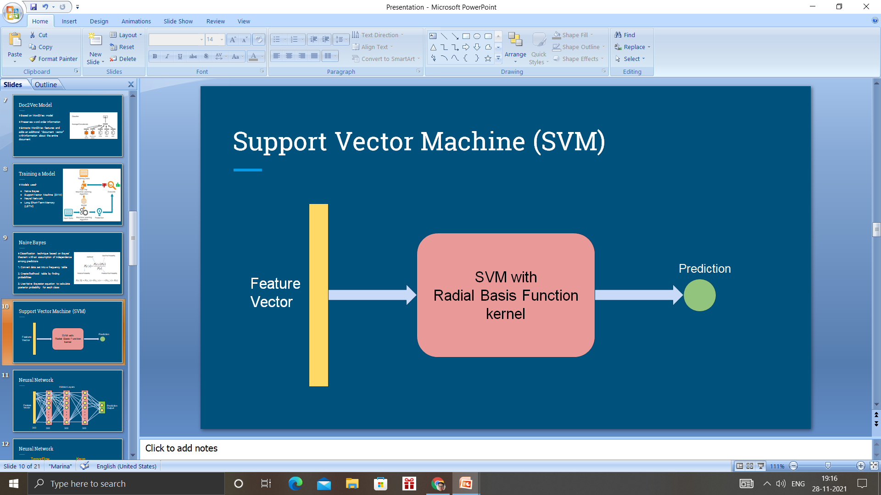
SVM
Support Vector Machine
Used interchangebly using Support vector Network(SVN)
Model is constructed post training of SVM
Distinguish the category for the new data
To find a hyperlane that divides the data in two groups
Notes:
https://www.researchgate.net/publication/334192809_A_Study_on_Fake_News_Detection_Using_Naive_Bayes_SVM_Neural_Networks_and_LSTM

Slide 11

Decision Tree
Contains only numeric and categorical kind of data.
Can’t examine continuous type of data.
Subtree replacement, Subtree Raising.
Notes:
https://www.researchgate.net/publication/350287290_Fake_News_Classification_Using_Random_Forest_and_Decision_Tree_J48

Slide 12
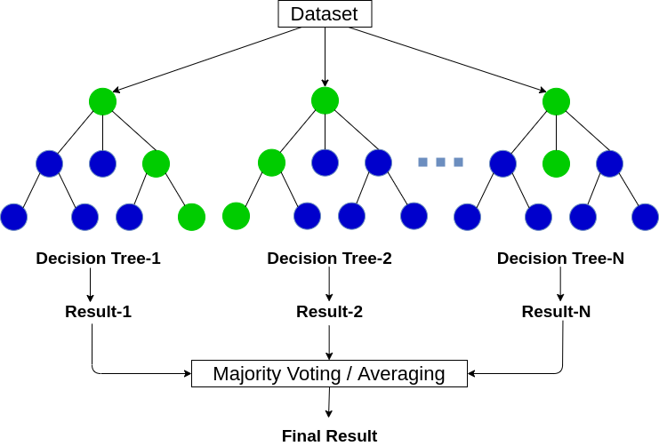
Random forest
Used for classification and regression issues.
Combination of several decision trees.
produces one class and bootstraps the votes to obtain the better accuracy from the technique.
At any node, a decision will be made.
Notes:
https://ijesc.org/upload/ef1625de3da5edd5ced54e70bc68663d.Identification%20of%20Fake%20News%20through%20SVM%20and%20Random%20Forest.pdf

Slide 13
Logistic Regression
Used to predict the probability of a categorical dependent variable.
The dependent variable is a binary variable.
It contains data coded as 1 (yes, success, etc) or 0 (no, failure, etc.).
Predicts P(Y=1) as a function of X
Notes:
https://www.irjet.net/archives/V6/i5/IRJET-V6I5733.pdf

Slide 14
Comparisons of Model
Model Name | Accuracy
Naïve Bayes | 95.80%
Logistic Regression | 99.10%
Decision Tree | 99.57%
Random Forest | 99.33%
Support Vector Machine | 99.62%

Slide 15
Graphical Representation

Slide 16
Confusion Matrix
Also known as an error matrix.
Table layout that allows visualization of the performance of an algorithm, typically a supervised learning one.
Compares the actual target values with those predicted by the machine learning model.
The name stems from the fact that it makes it easy to see whether the system is confusing two classes.

Slide 17
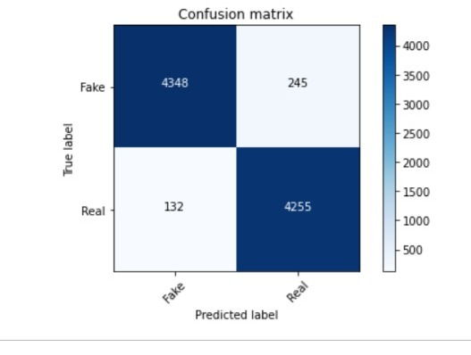
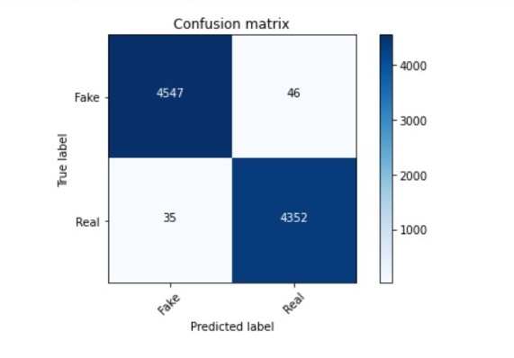
Confusion Matrix
Naïve Bayes
Logistic Regression

Slide 18
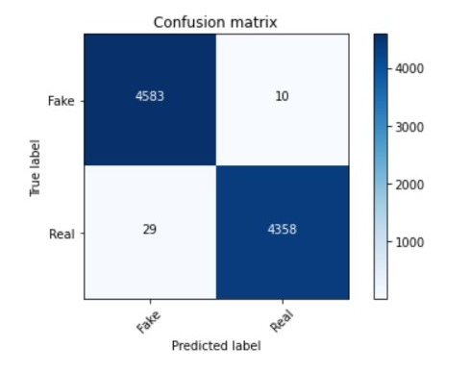
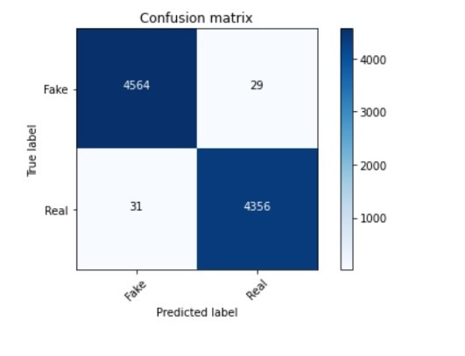
Confusion Matrix
Decision Tree
Random Forest

Slide 19
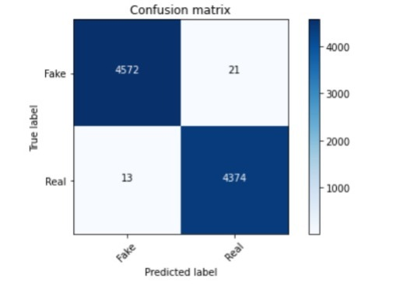
Confusion Matrix
SVM

Slide 20
Challenges
Lack of clean data to directly work with might have slowed down our progress
Content based classification is just a part of the whole picture
Distinguish between click-bait and actual fake news

Slide 21
Future Work
To add more datasets to check the credibility of our existing system.
Include more algorithms to the current system
Introduce the web version of the existing system with the help of Google flask and web development.

Slide 22

A special thanks to our mentor Amir Khan Sir(Technical Trainer) for providing his assistance to us whenever we required it.

Slide 23
References
Fake News Detection: A Data Mining Perspective
Fake News Identification - Stanford CS 229
BS Detector
Datasets from Kaggle

